Slide 1
Introduction
When images are captured in an outdoor environment, they may suffer from low contrast, poor visibility, dark, and inconsistent colors due to the presence of haze or fog
Haze removal from such images is an important requirement for computational photography as well as several computer vision tasks
In this presentation, I am presenting you a method to enhance and dehaze an RGB image
The proposed method is based on some standard algorithms which are presented in the following slides

Slide 2
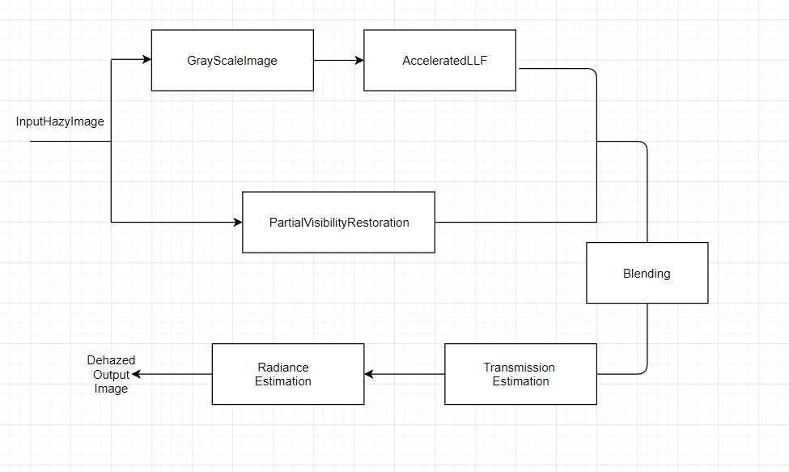
Flow Chart

Slide 3
GRAY SCALE IMAGE
RGB scale image Grey Scale Image
2 ways two convert RGB image into Grey Scale Image
Average Method
Weighted Method

Slide 4
Average Method
Take the average of three colors
Grayscale = (R + G + B / 3)
Problem
While taking average we are considering that in an image, contribution of R G and B are equal, which is not the case most of the times.

Slide 5
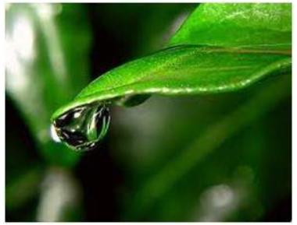
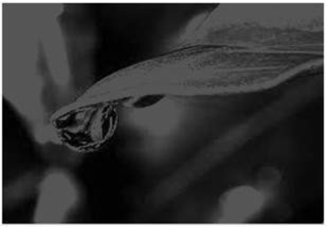
Average Method
RGB Image
Grey Scale Image

Slide 6
Weighted Method
Red color has more wavelength of all the three colors
Green has least wavelength among these three colors.
Green color is most soothing to the eyes too.
Contribution of green color ↑
Contribution of red color ↓
New grey image = ((0.3*R)+(0.59*G)+(0.11*B))

Slide 7
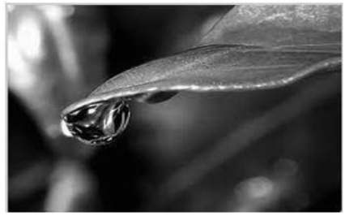
Weighted Method
Original Image
Grey Scale

Slide 8
Accelerated LLF
Input image is processed by constructing the Laplacian pyramid {L[I']} of the output.
Generate an intermediate image ḹ by applying a point-wise monotonic remapping function r_{g,σ}(·) to the original full-resolution image.
Compute the pyramid for the intermediate image {L[ḹ]} and copy the corresponding coefficient to the output {L[I']}.
After all coefficients of the output pyramid have been computed, we collapse the output pyramid to get the final result.

Slide 9
Remapping function
Set α as threshold
α is a variable of intensity
Variations less than σ are considered as fine scale details
Variations more than σ are considered as edges
If g represents the intensity at any location then r(i) = r_{d}(i) if |i – g| ≤ σ and r(i) = r_{e}(i) otherwise.
To avoid discontinuties r_{d}(g ± σ) = r_{e}(g ± σ)

Slide 10
Hybrid Median Filter Algorithm
Place a cross-window over element
Pick up elements
Order elements
Take the middle element
Place a X-window over element
Pick up elements
Order elements
Take the middle element
Pick up result in point 4, 8 and element itself
Order elements
Take the middle element

Slide 11
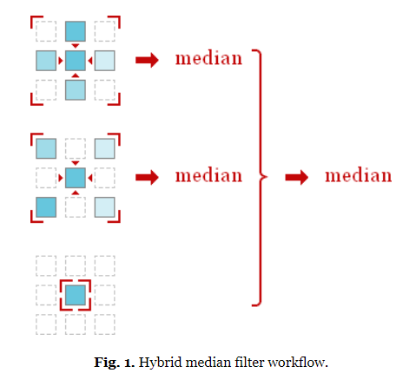
Hybrid Median Filter

Slide 12
Hybrid Median Filter Algorithm
The algorithm mentioned in previous slide would fail at edge, therefore we need to make some arrangements before applying HMF.
We add lines at the top and at the bottom of the image
We add columns to the left and to the right of it

Slide 13
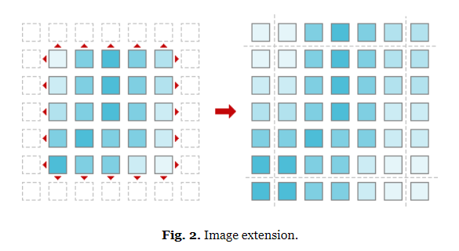
Hybrid Median Filter

Slide 14
Blending
Take an image P1 . Let P1(i , j) denote pixel value at (i , j).
Take an image P2 . Let P2(i , j) denote pixel value at (i , j).
Q(i , j) = X*P1(i , j) + (1-X)*P2(i , j)
Here X is blending ration which determines the influence of each image in the output and Q(i , j)
is the resulting image pixel at (i , j).

Slide 15
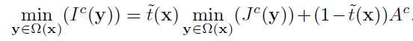
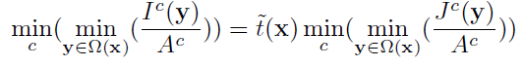
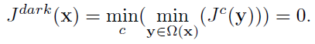
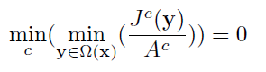
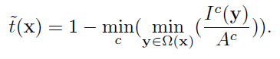
Transmission
We start from a basic equation
&
Here A is atmospheric light

Slide 16
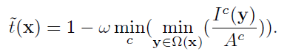
Depth Estimation
Presence of Haze is a fundamental cue for human to perceive depth
We must not remove haze completely otherwise image might look unnatural and feeling of depth may be lost
That’s why we define transmission differently for practical purposes
value of w is application based, here w=0.95
With the help of above expression, we try to plot transmission map

Slide 17
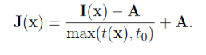
Radiance
With the help of given equation and transmission map, we can find the radiance
I(x) = J(x) t(x) + A (1 - t(x) )
Here J(x) is the radiance
J(x) t(x) can be very close to 0, when t(x) is close to 0
We restrict the transmission t(x) to a lower bound t0, this will ensure a small amount of haze is preserved for naturalness of image
Final J(x) is recovered by:
t0 is typically 0.1

Slide 18
Atmospheric Light
We first pick the top 0.1% brightest pixels in the dark channel
These pixels are most opaque
Among these pixels, the pixels with highest intensity in the input image I is selected as the atmospheric light
These pixels may not be brightest in the whole image.

Slide 19
Walking through the flow chart
Take an hazy input image
Convert The RGB hazy image into grey scale image
Apply Accelerated local laplacian filter to the grey scale image
Separately apply Hybrid Median Filter to the hazy input image
Now blend together the outputs from the 2 filters using fore mentioned blending algorithm.
Get the transmission map of the blending output, it will give an approximate estimation of the depth of the image
Use the transmission map to get Radiance of the output image

Slide 20
RESULTS
IMAGE | t = 0.7 |  |  |  | t = 0.6 |  |  |  | t = 0.5
 | DE haze-net |  | Proposed Method |  | DE haze-net |  | Proposed Method |  | DE haze-net |  | Proposed Method
 | PSNR | SSIM | PSNR | SSIM | PSNR | SSIM | PSNR | SSIM | PSNR | SSIM | PSNR | SSIM
ALOE | 27.02 | 0.976 | 22.05 | 0.966 | 29.97 | 0.97 | 27.31 | 0.97 | 26.32 | 0.959 | 23.651 | 0.952
BOOKS | 27.48 | 0.969 | 19.78 | 0.948 | 25.11 | 0.97 | 22.38 | 0.95 | 21.11 | 0.952 | 20.70 | 0.928
CONES | 25.18 | 0.986 | 21.94 | 0.965 | 20.53 | 0.96 | 25.04 | 0.965 | 16.94 | 0.93 | 20.14 | 0.92
DRUMSTICKS | 26.43 | 0.939 | 24.39 | 0.934 | 21.97 | 0.92 | 19.36 | 0.885 | 17.64 | 0.86 | 14.88 | 0.806
TEDDY | 27.31 | 0.961 | 20.46 | 0.944 | 22.89 | 0.94 | 21.84 | 0.935 | 18.94 | 0.90 | 18.43 | 0.895

Slide 21
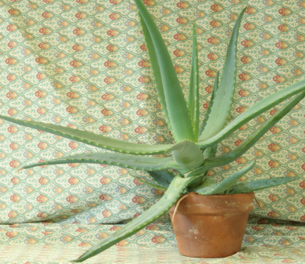
Aloe

Slide 22
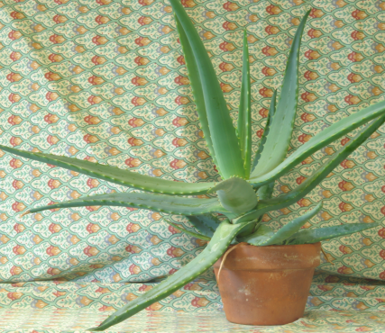
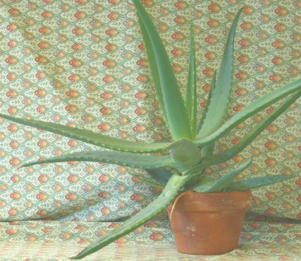
Aloe (t = 0.7)
DE haze net
Proposed

Slide 23
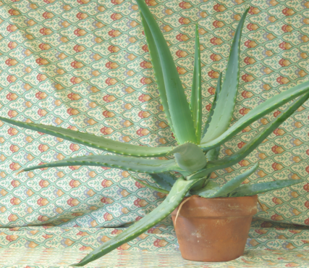
Aloe (t = 0.6)
DE haze net
Proposed

Slide 24
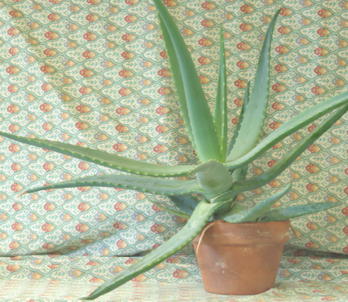
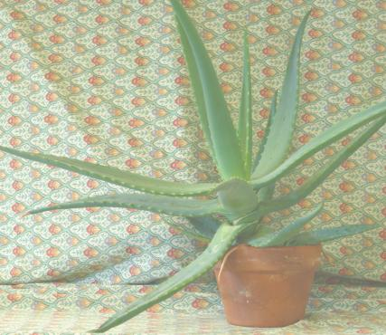
Aloe (t = 0.5)
DE haze net
Proposed

Slide 25
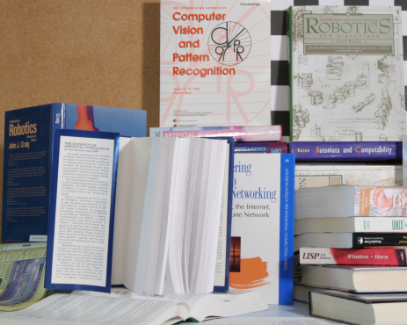
Books

Slide 26
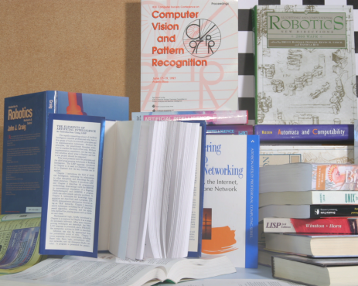
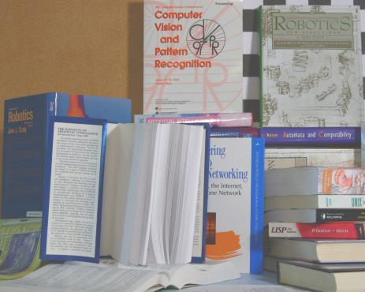
Books (t = 0.7)
DE haze net
Proposed

Slide 27
Books (t = 0.6)
DE haze net
Proposed

Slide 28
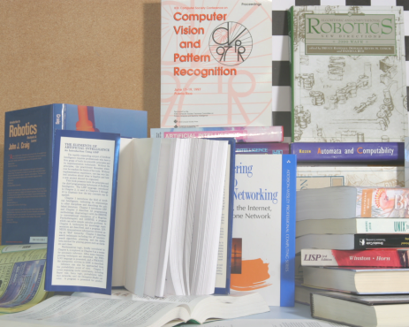
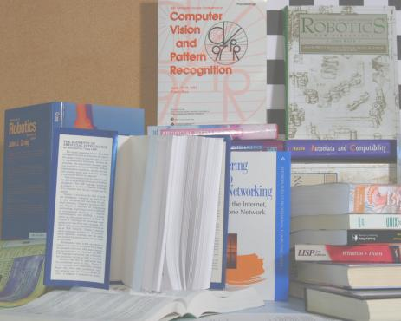
Books (t = 0.5)
DE haze net
Proposed

Slide 29
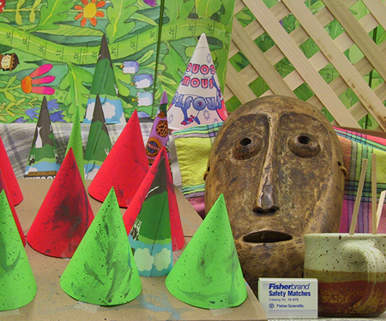
Cones

Slide 30
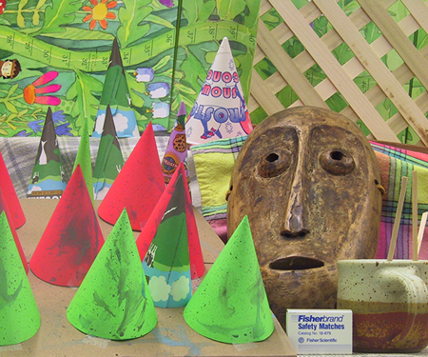
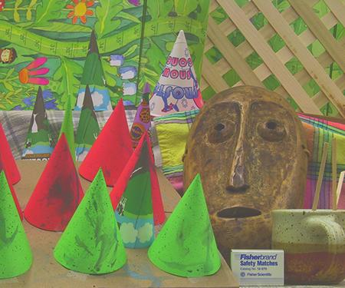
Cones (t = 0.7)
DE haze net
Proposed

Slide 31
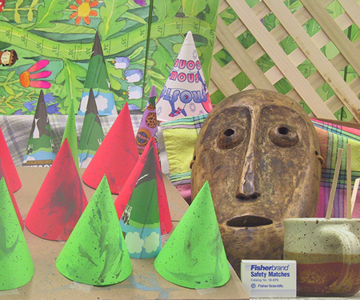
Cones (t = 0.6)
DE haze net
Proposed

Slide 32
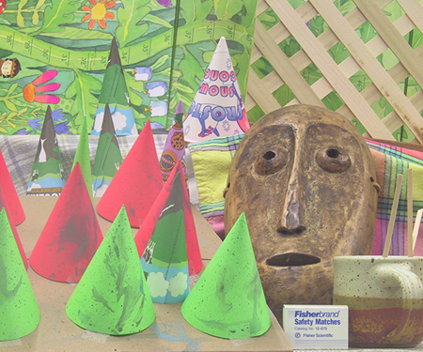
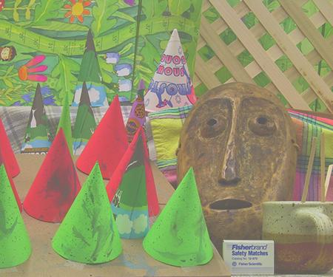
Cones (t = 0.5)
DE haze net
Proposed

